Slide 1
The State of Ageing 2022

Slide 2
This set of slides brings together findings from ‘The State of Ageing 2022’, an online interactive report.
We’re offering this PowerPoint for you to use in your own presentations, but we ask that you retain references to the Centre for Ageing Better.
For full descriptions, sources and explanation of the data that’s presented, please read the online report.

Slide 3
Work
Over 50s ‒ who face many barriers to re-employment ‒ are being left behind in the post-pandemic employment recovery

Slide 4
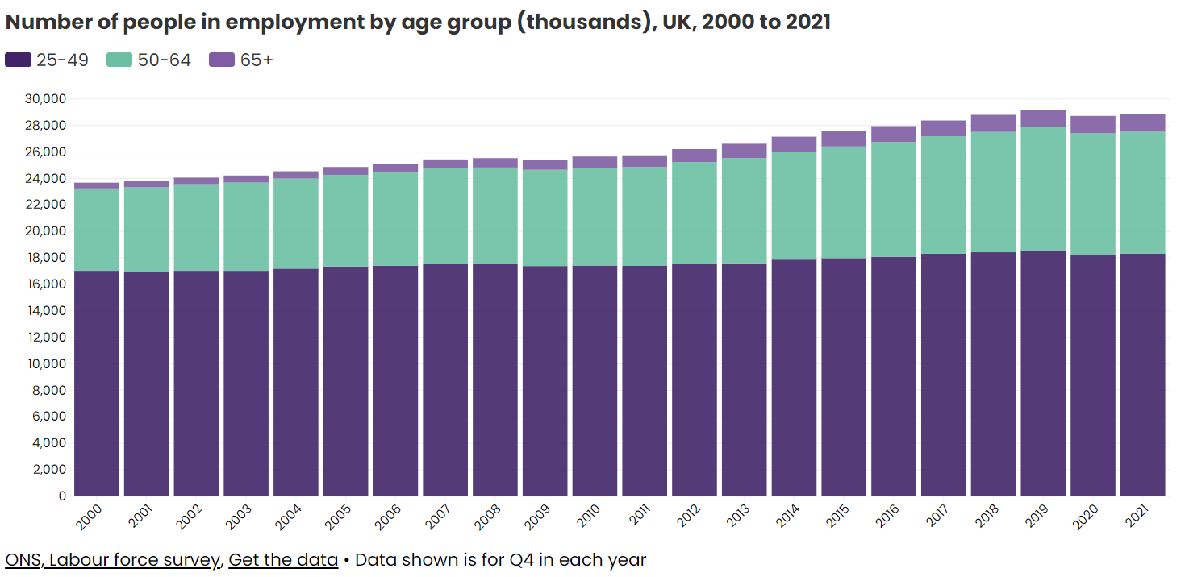
The number of over 50s in the workplace has grown dramatically over the last 20 years – but there has been a sharp drop-off since before the pandemic

Slide 6
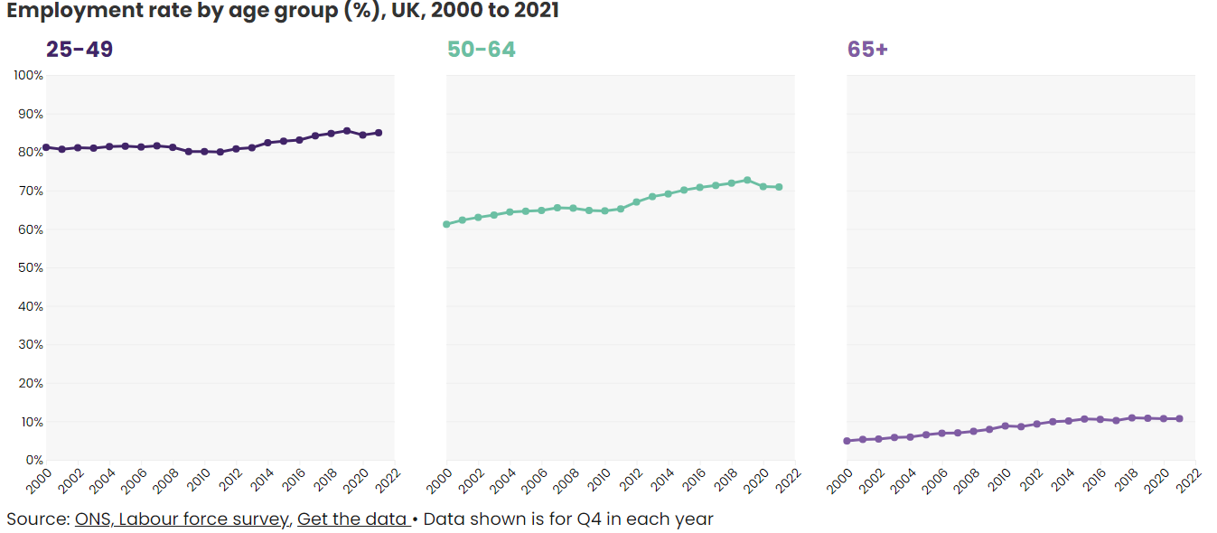
The pandemic risks putting decades of older worker employment growth into reverse – and the employment gap between older and younger workers has grown

Slide 7
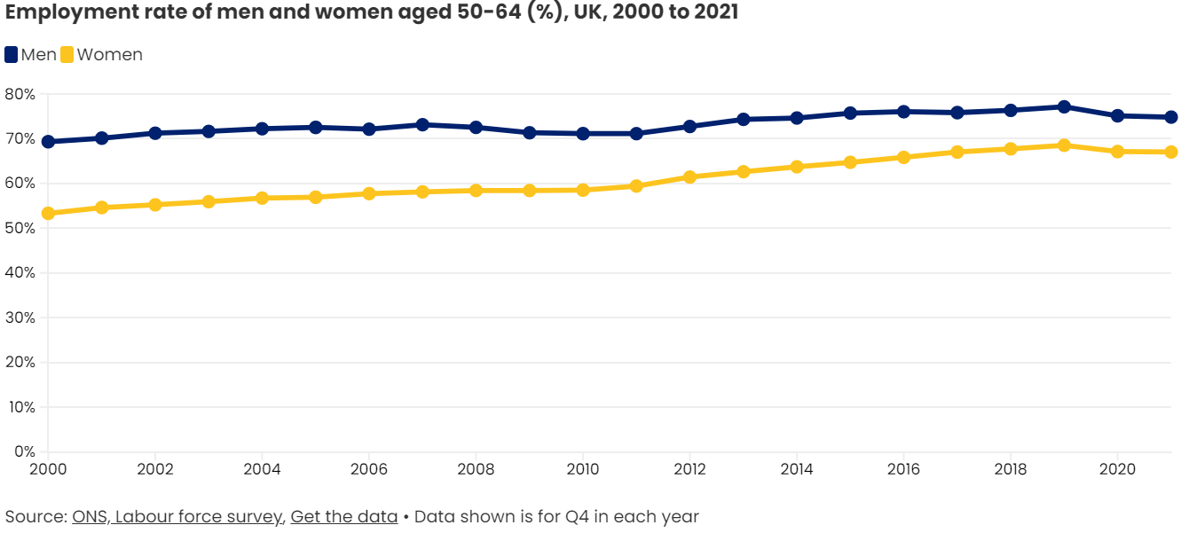
The gap in the employment rate of men and women aged 50-64 has narrowed slightly since the start of the pandemic

Slide 8
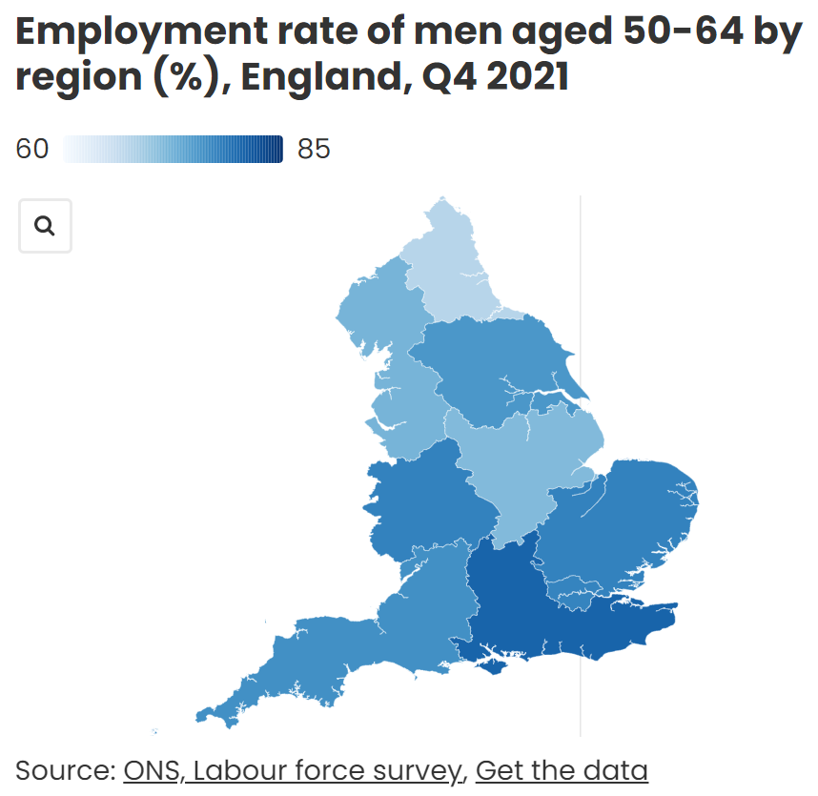
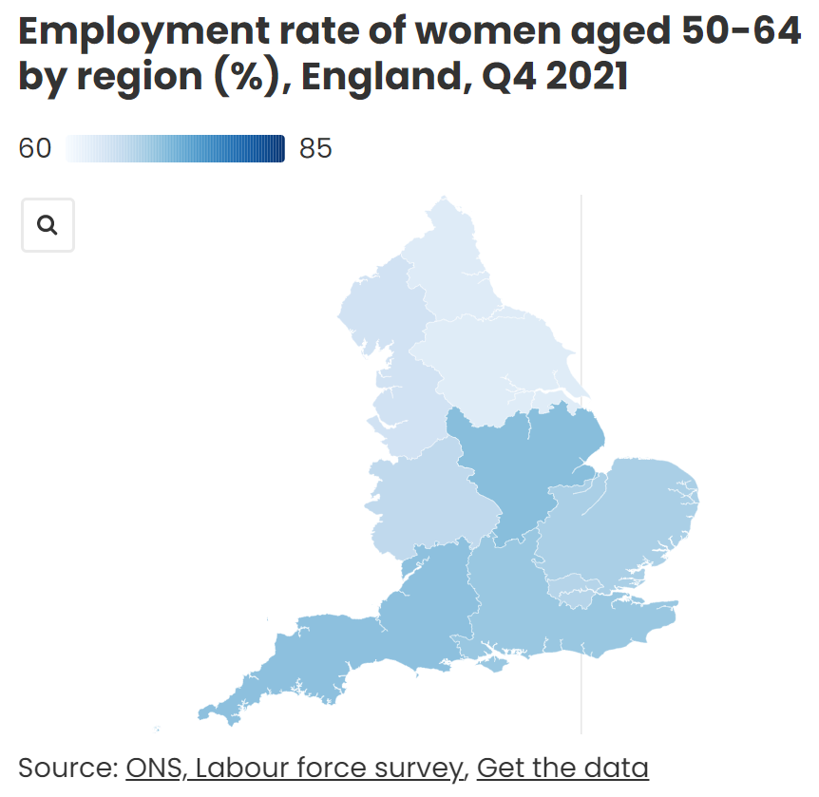
The employment rate of 50-64 year olds varies hugely across the country

Slide 9
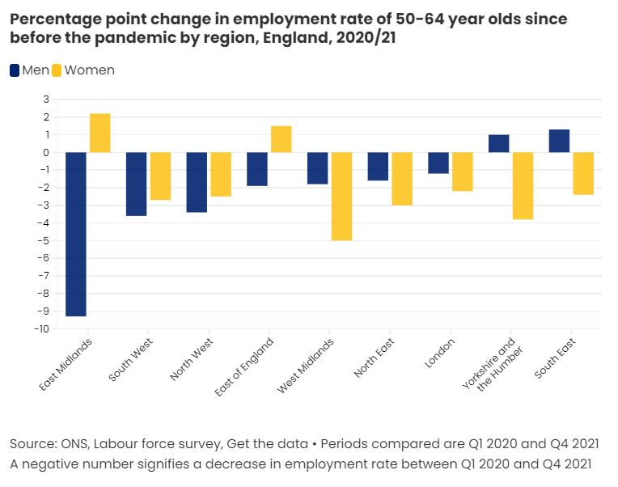
There is large regional variation in how the pandemic has impacted older workers

Slide 10
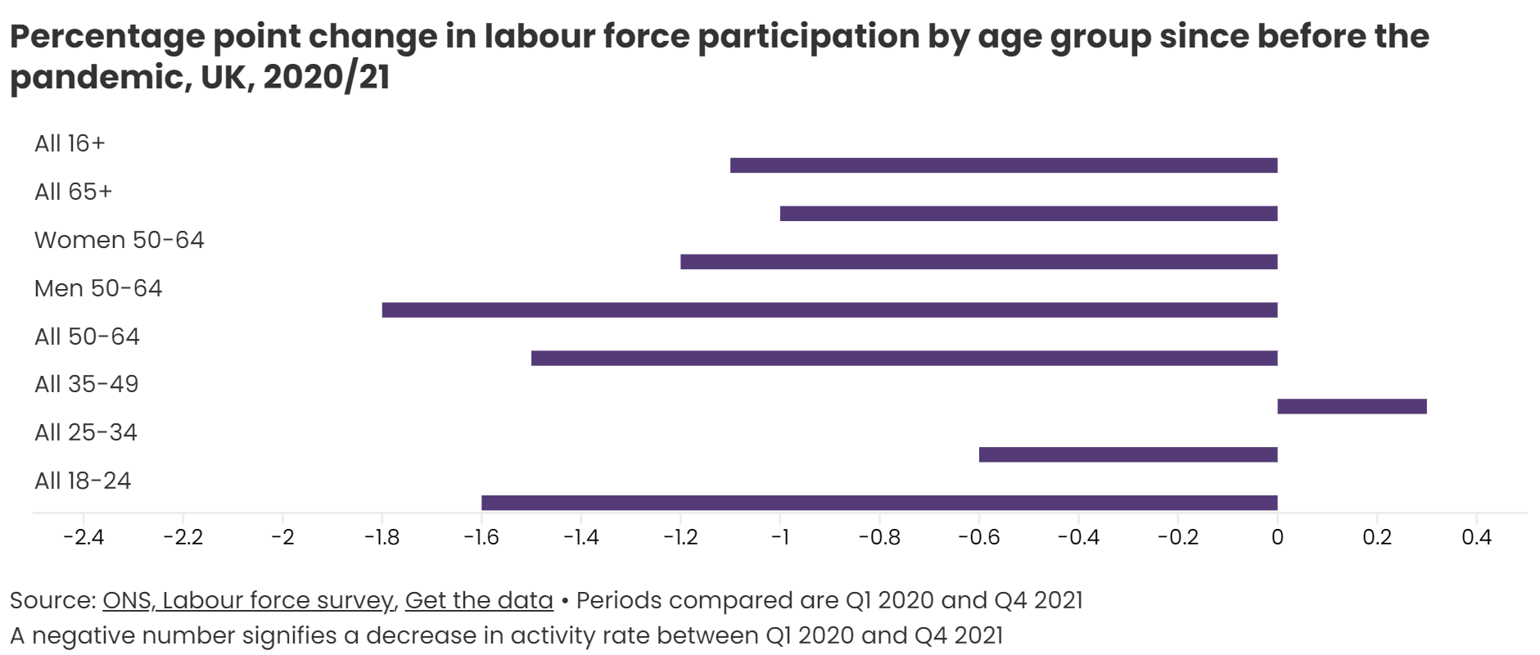
As of Q4 2021, there were 126,000 more economically inactive men and 102,000 more economically inactive women aged 50-64 than before the pandemic

Slide 11
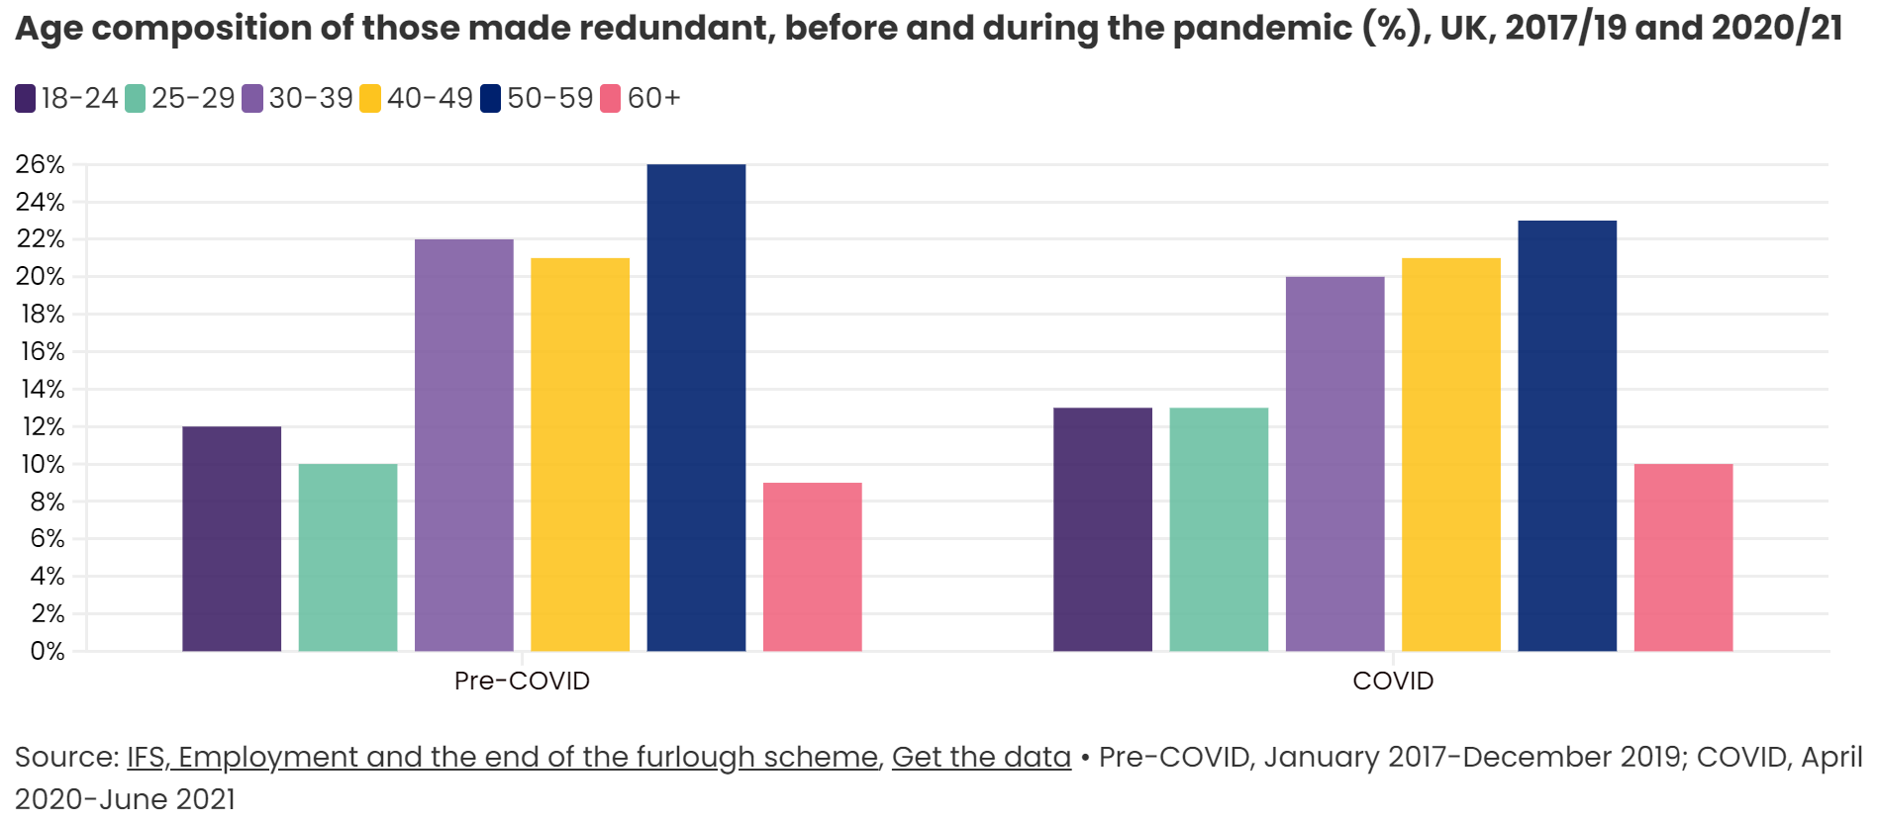
One-third of people made redundant during the pandemic were aged 50 or over

Slide 12
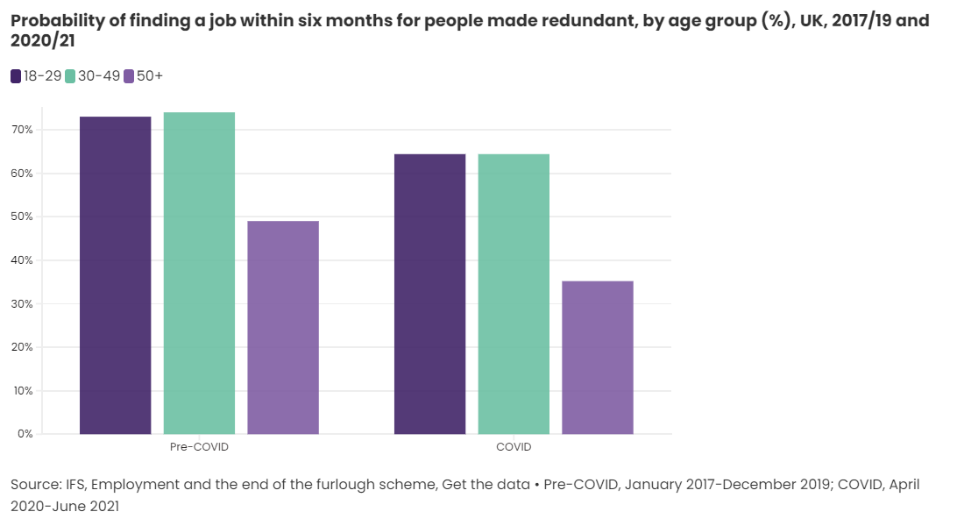
Redundant workers aged 50 and over were half as likely as younger workers to be re-employed during the pandemic

Slide 13
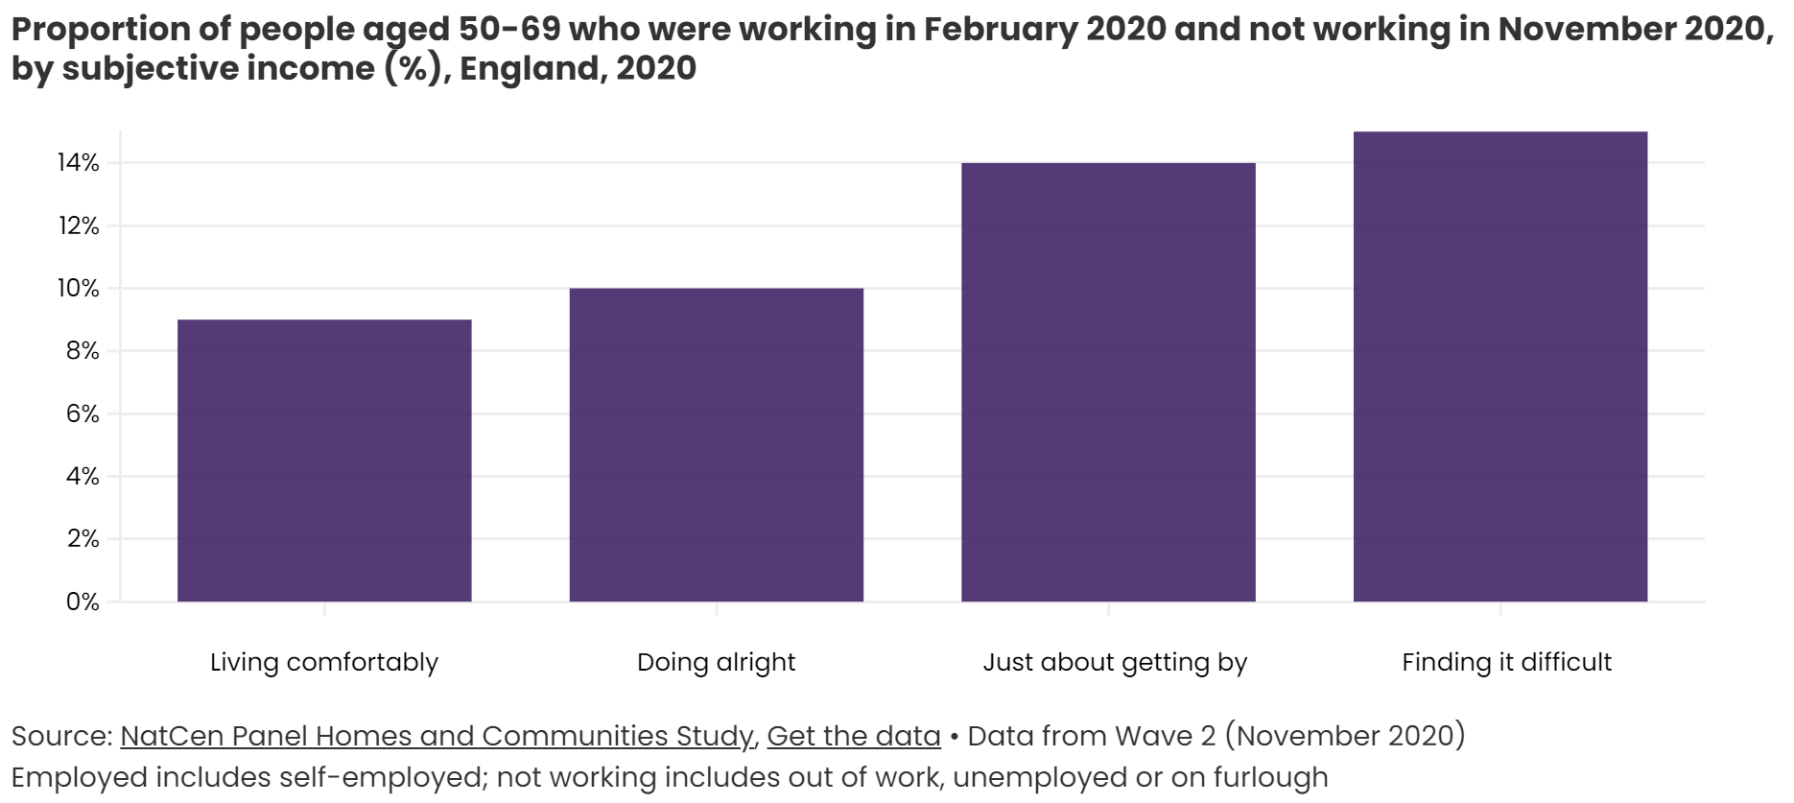
The least well-off were the most likely to fall out of work during the pandemic

Slide 14
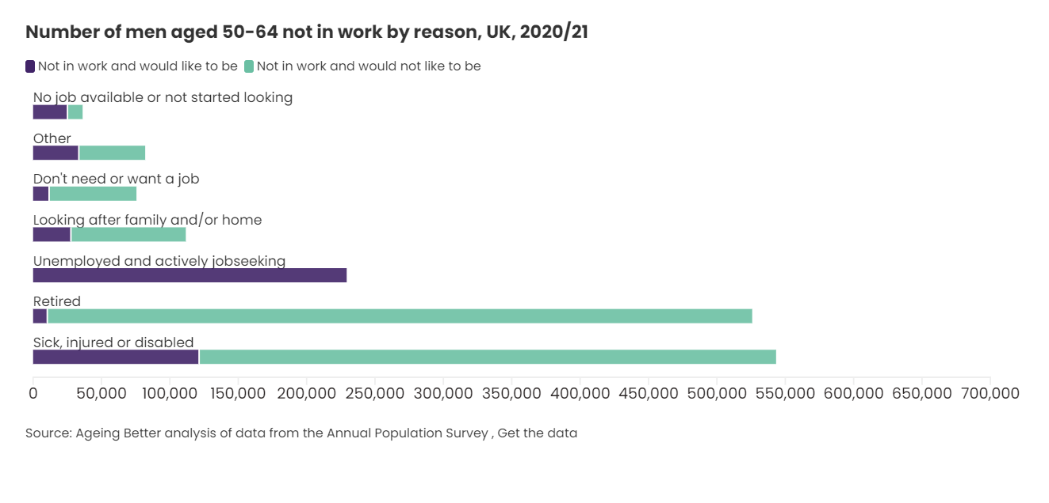
Poor health, followed by retirement, are the main reasons men aged 50-64 are out of work

Slide 15
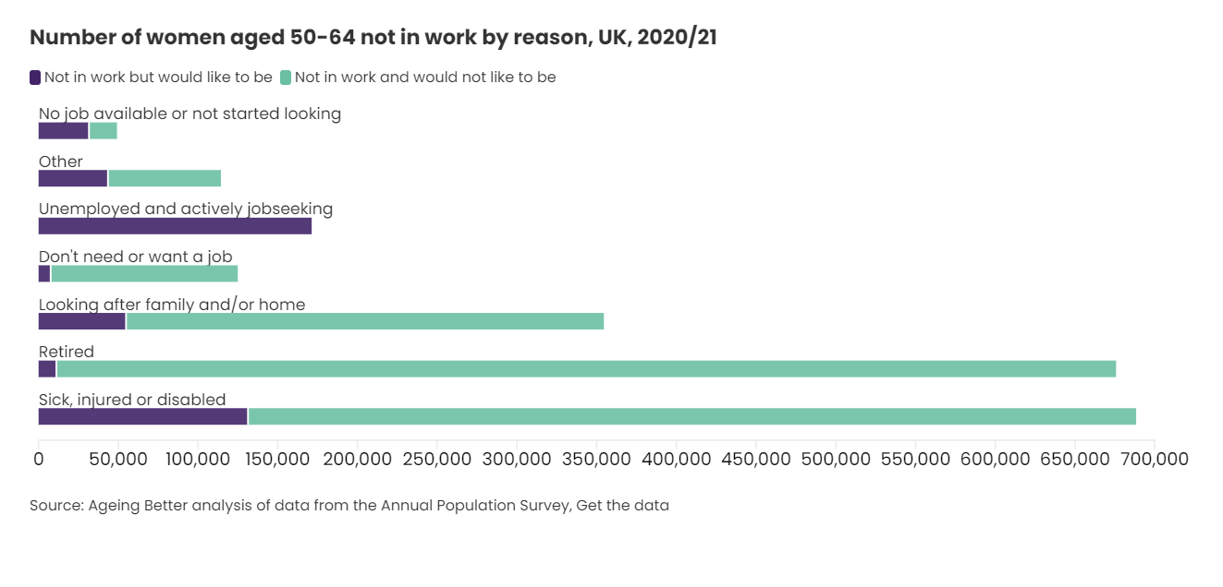
Poor health is the main reason women aged 50-64 are out of work

Slide 16
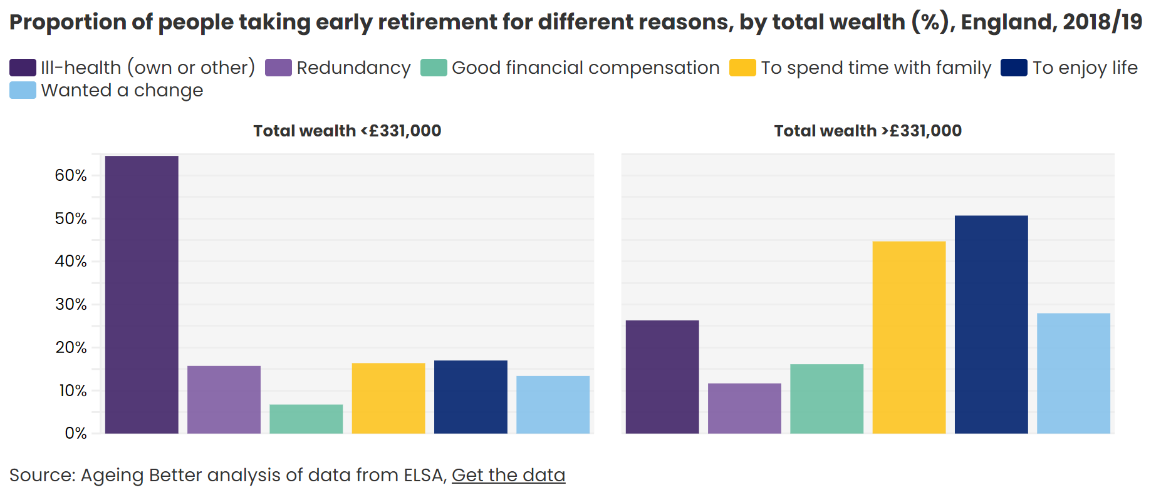
The poorest people are most likely to have taken early retirement because of their own poor health, or that of others

Slide 17
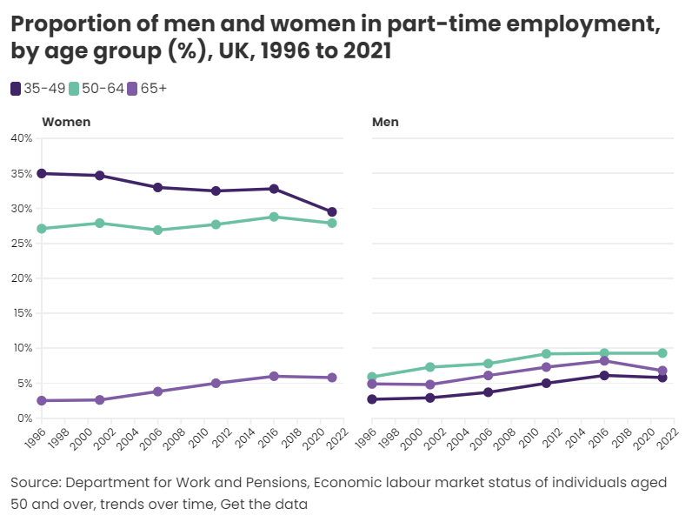
There are three times more women aged 50-64 working part-time than men

Slide 18
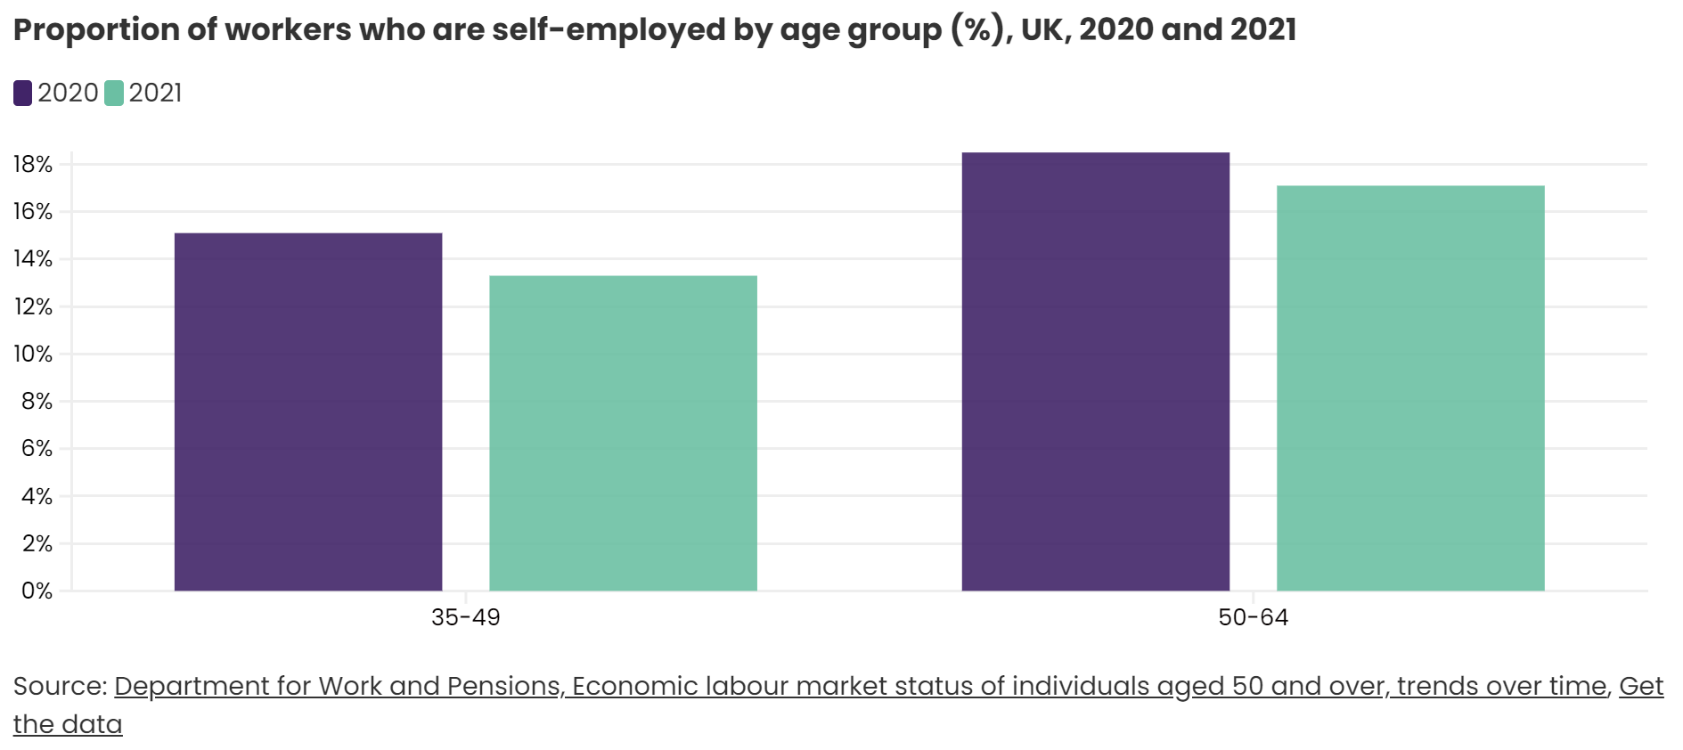
Self-employment is more common among older than younger people, but rates have fallen during the pandemic

Slide 19
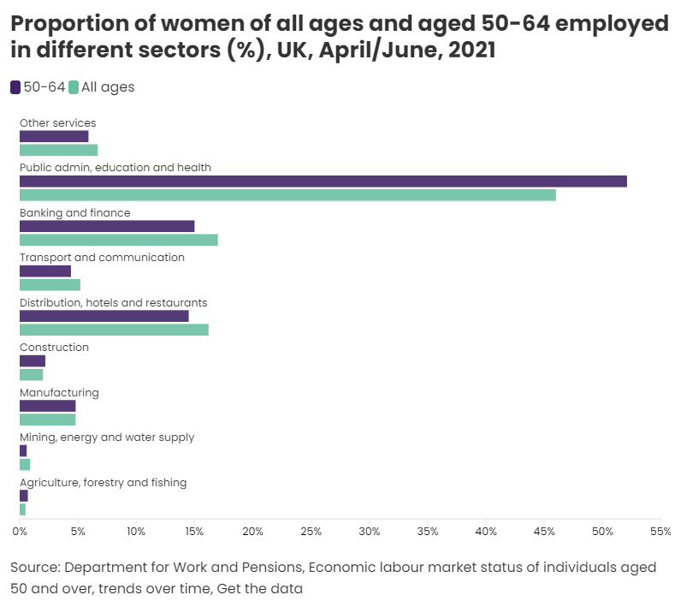
More than half of women aged 50-64 are employed in public administration, education and health

Slide 20
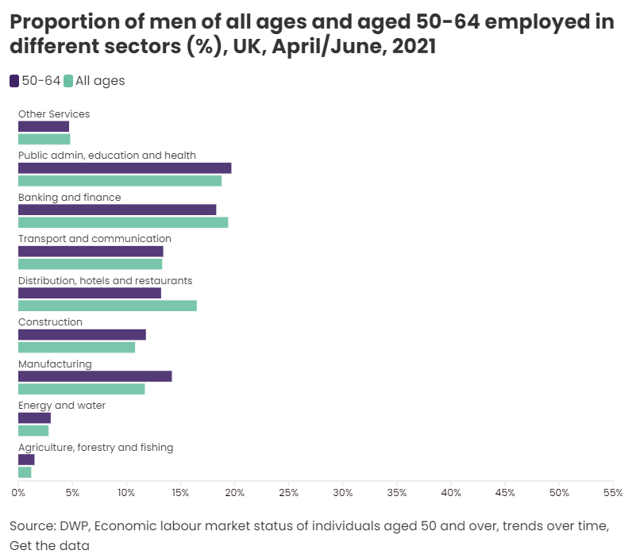
There is more even distribution of employment across industry sectors for men than for women

Slide 21
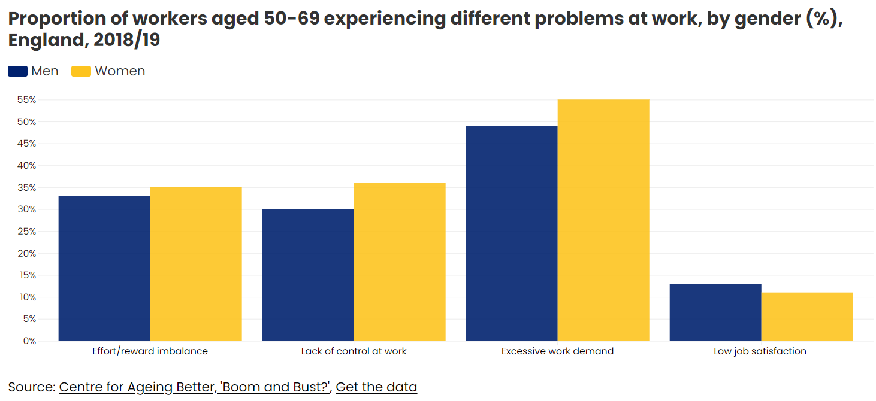
Poor-quality work is an issue for a large number of people in their fifties and sixties

Slide 22
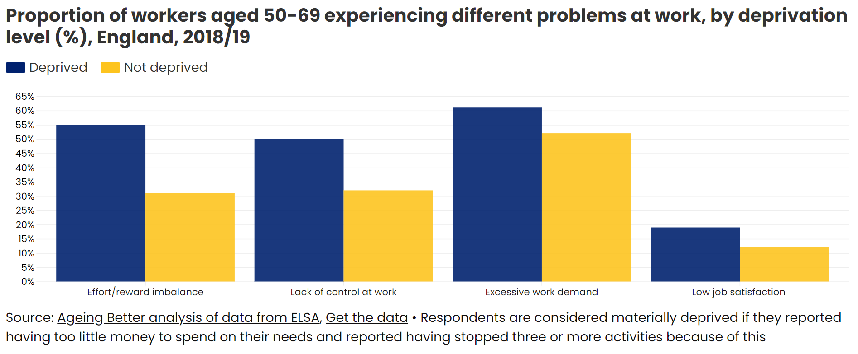
Poor-quality work is much more common among poorer workers

Slide 23
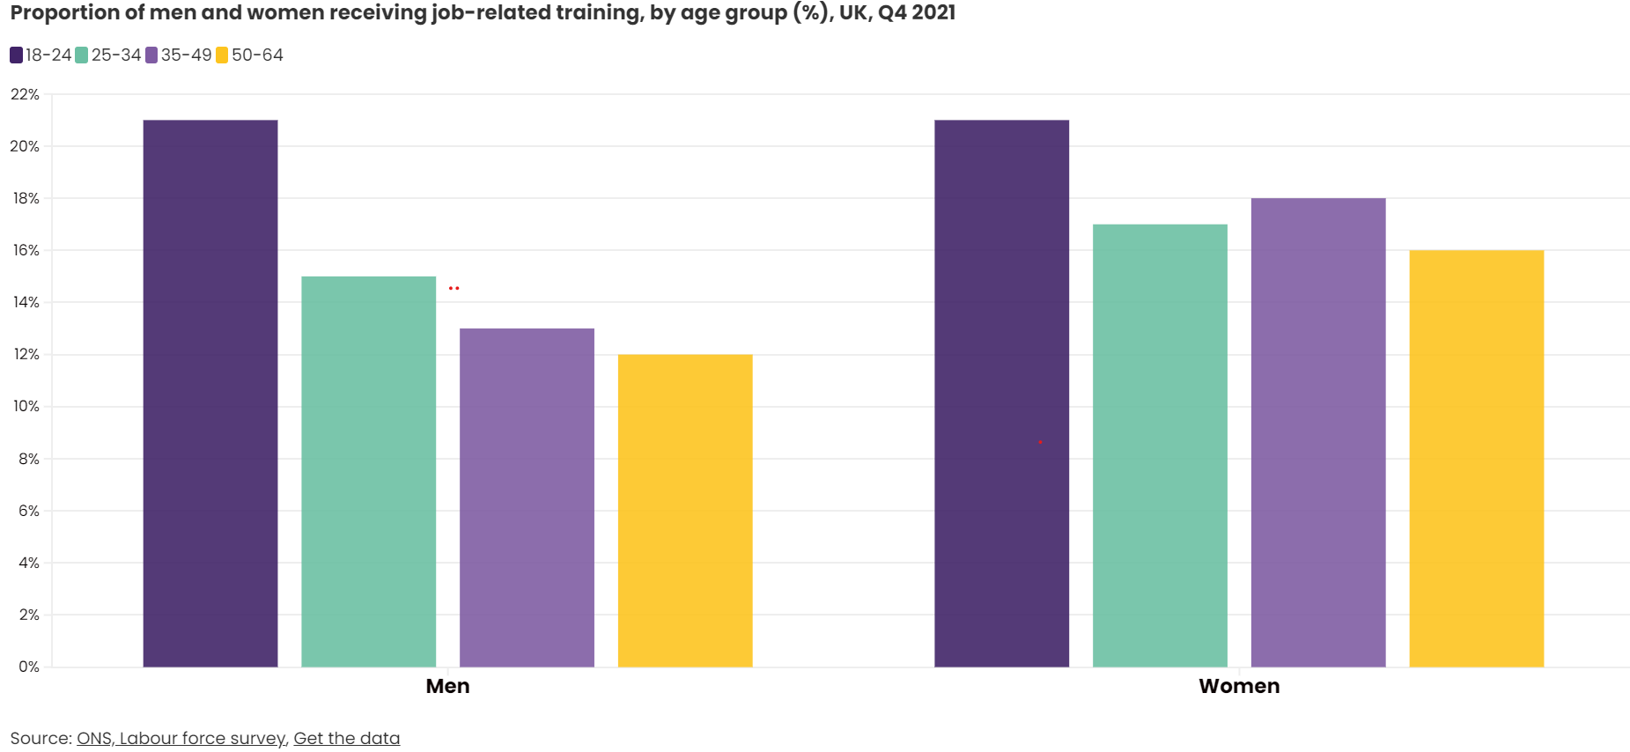
Workers aged 50 and over are the least likely to receive job-related training

Slide 24
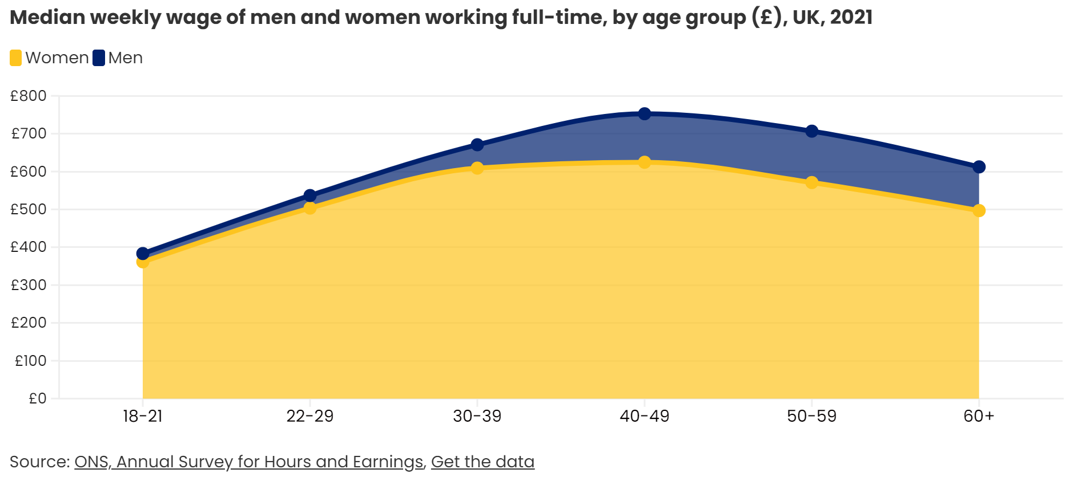
The gender pay gap of people in their fifties has narrowed slightly but men still make more than women

Slide 25
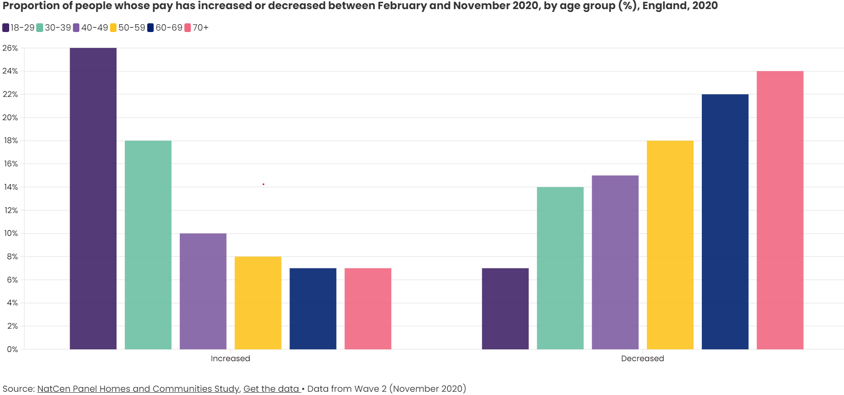
The likelihood of having a decrease in pay increased with age over the pandemic

Slide 26
Housing
An increasing number of people are renting rather than owning their own homes in later life. And millions of privately-rented homes are bad for people's health.

Slide 27
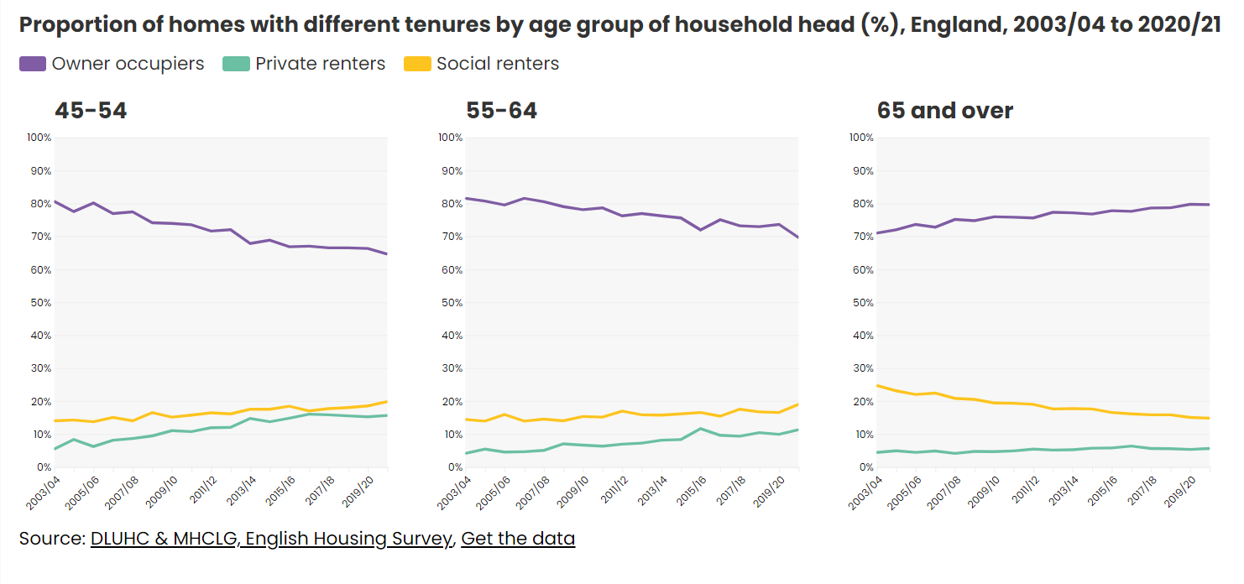
Most older people own their home

Slide 28
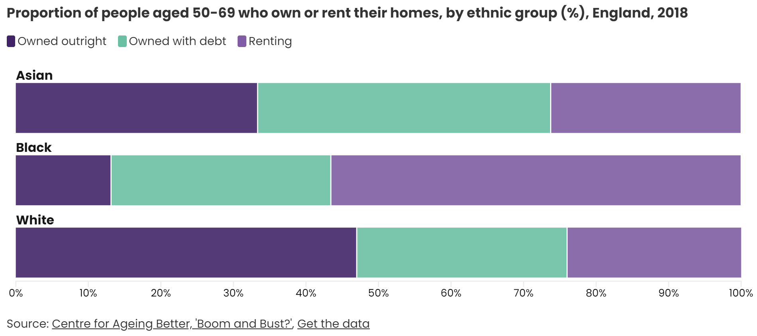
There are large disparities in home ownership between different ethnic groups

Slide 29
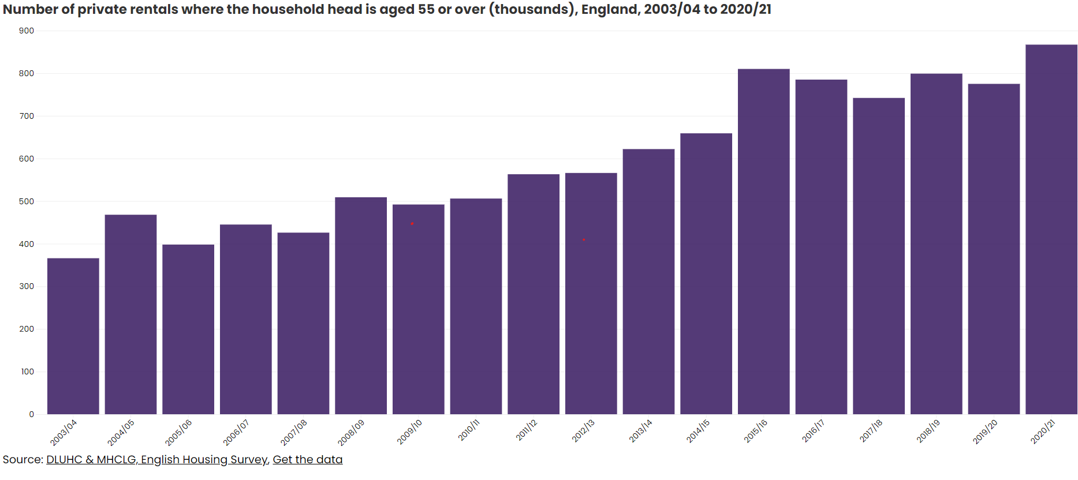
Since 2003, the number of people aged 55 and over renting privately has more than doubled – a trend that is set to continue
867,000

Slide 31
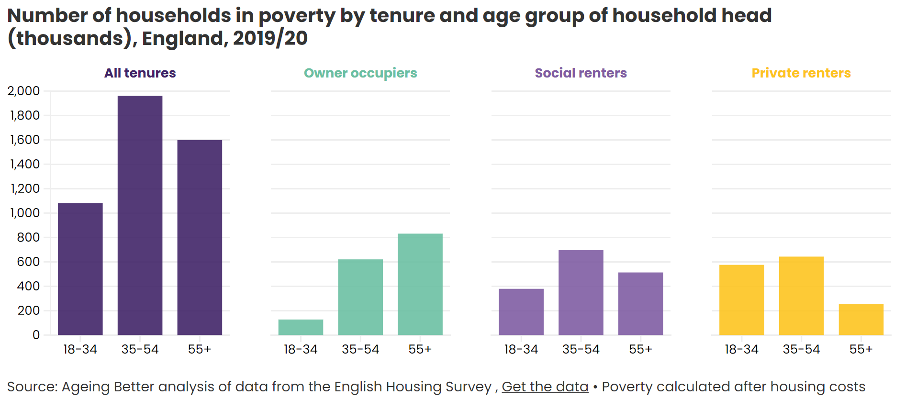
1.6 million households headed by someone 55 or over are in poverty

Slide 32
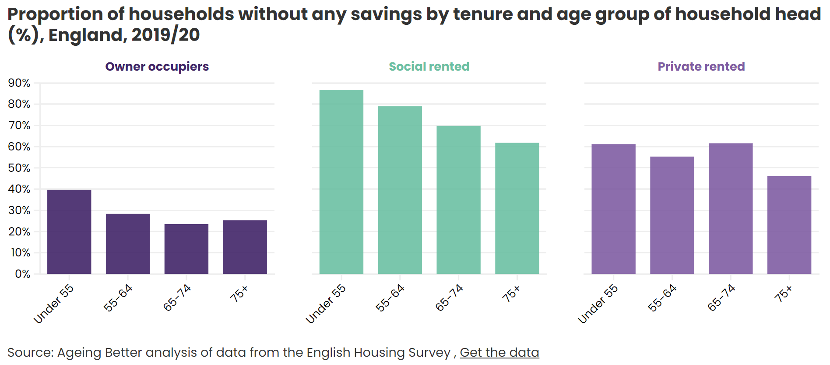
Two-thirds of households that are privately rented by someone aged 65-74 have no savings

Slide 33
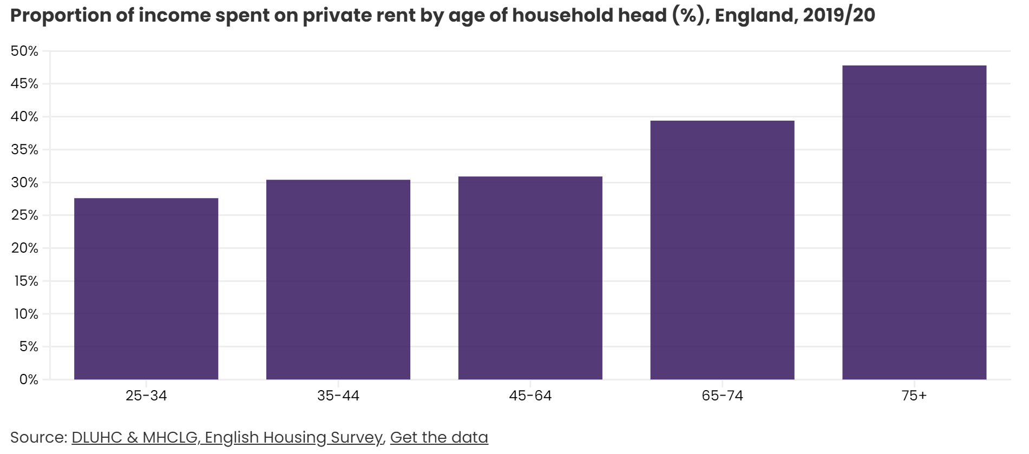
The proportion of income that is spent on private rent rises steadily with age

Slide 34
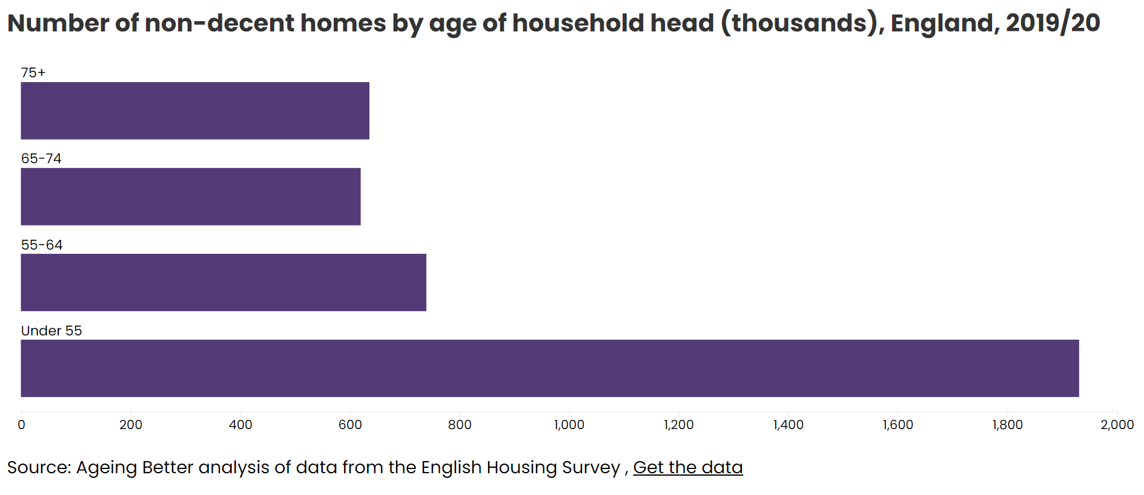
There are almost 4 million non-decent homes in England; more than half of these are lived in by someone aged 55 or older

Slide 35
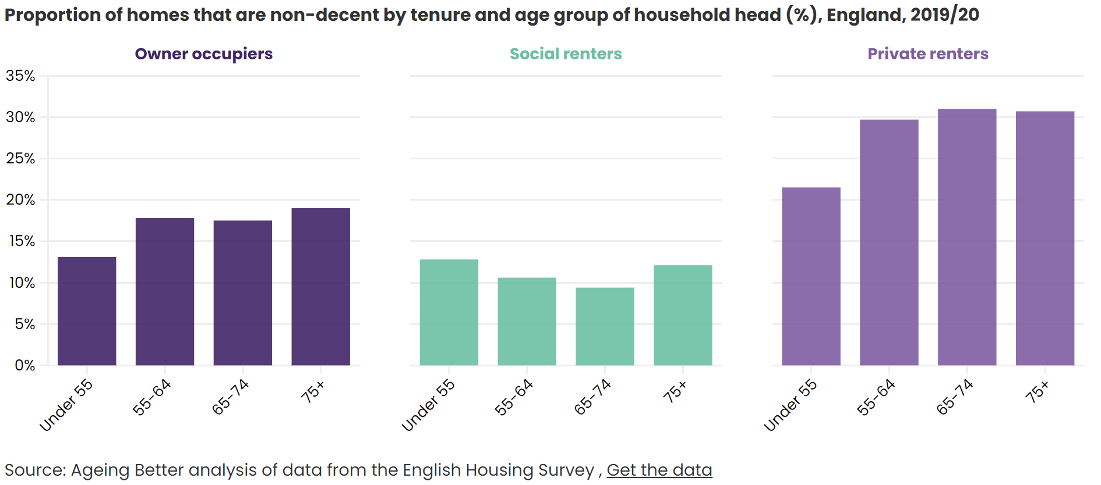
The likelihood of living in a non-decent home is highest in the private rented sector

Slide 36
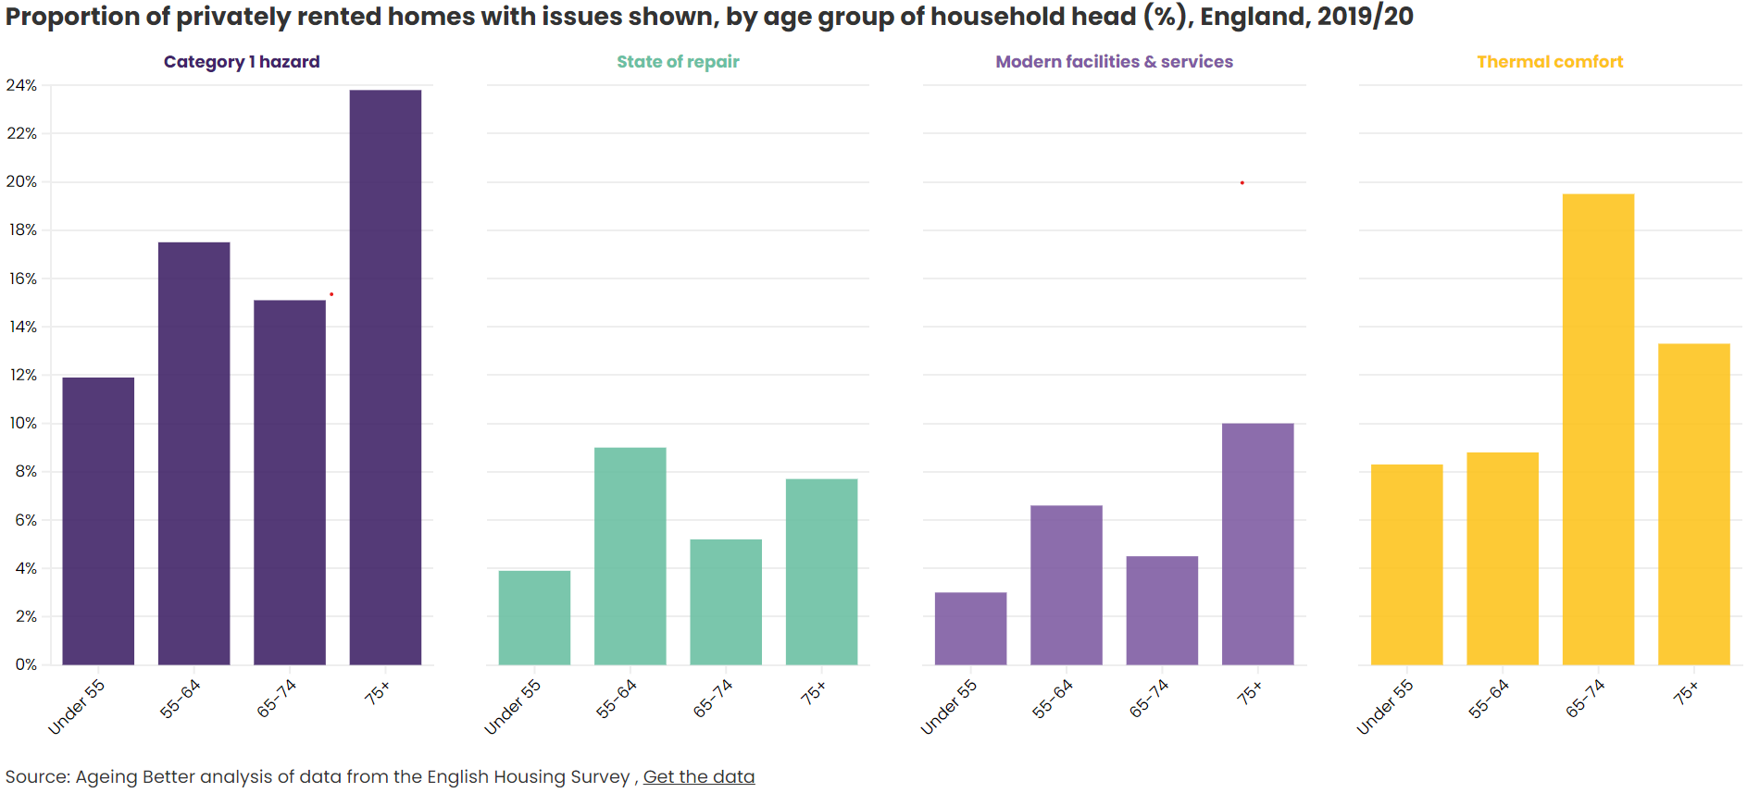
Almost a quarter of people aged 75 and over who rent privately are at risk from category 1 hazards

Slide 37
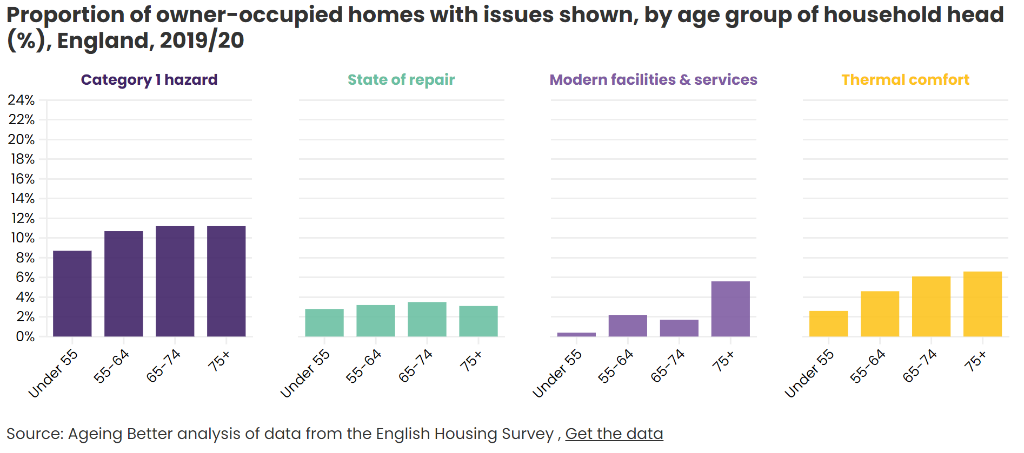
The likelihood of a category 1 hazard in owner-occupied homes increases with the age of the head of household

Slide 38
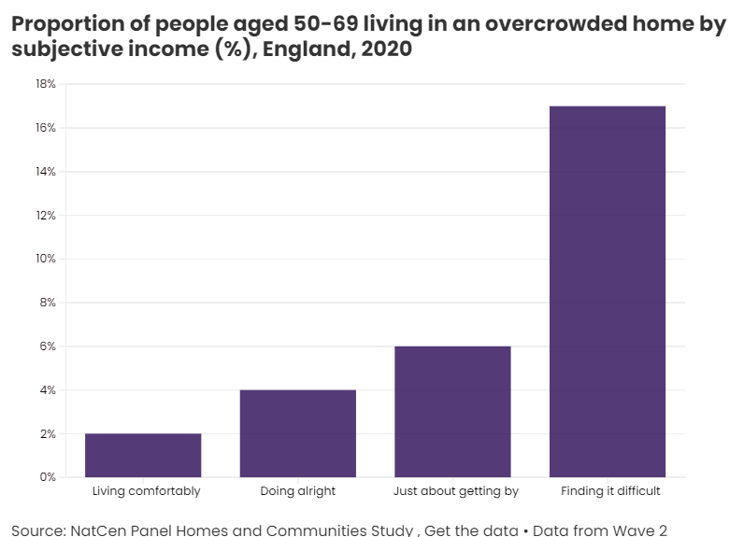
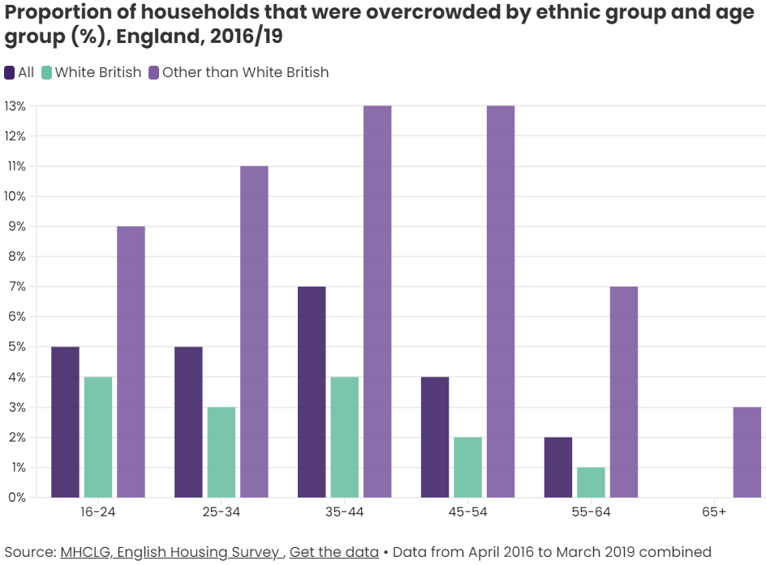
The poorest people and those from a minority ethnic background are the most likely to be living in an overcrowded home

Slide 39
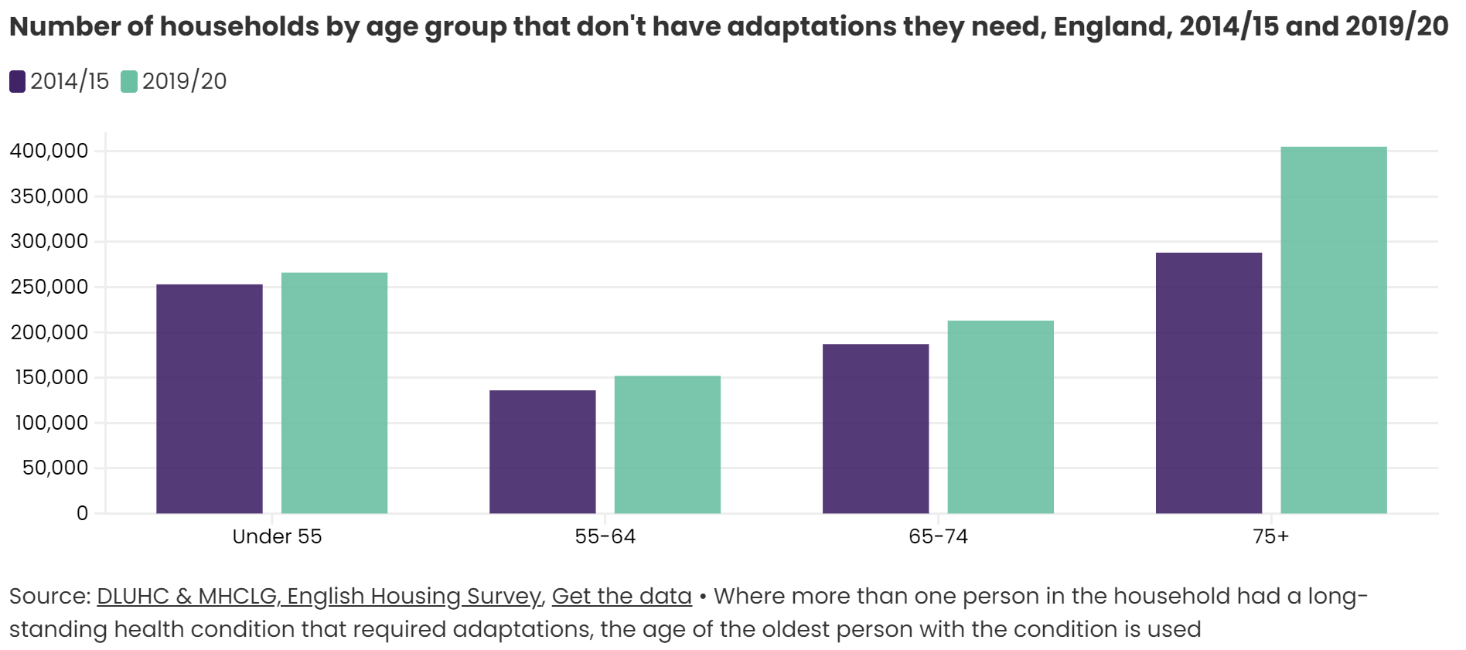
A total of 1 million homes do not have the adaptations they need

Slide 40
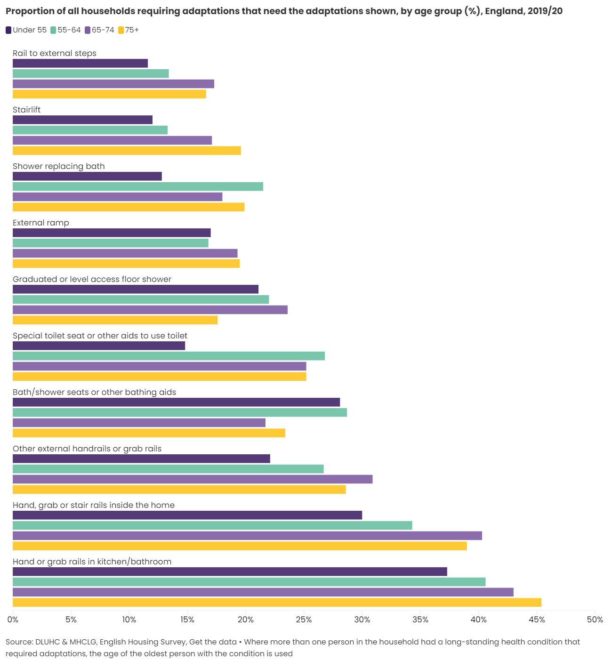
Hand and grab rails are the adaptations most commonly needed in our homes

Slide 41
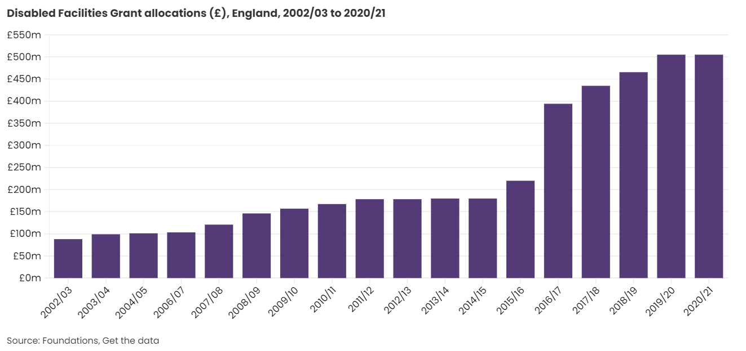
Over £500 million was allocated to pay for adaptations to homes in England in 2020/21 through the Disabled Facilities Grant

Slide 42
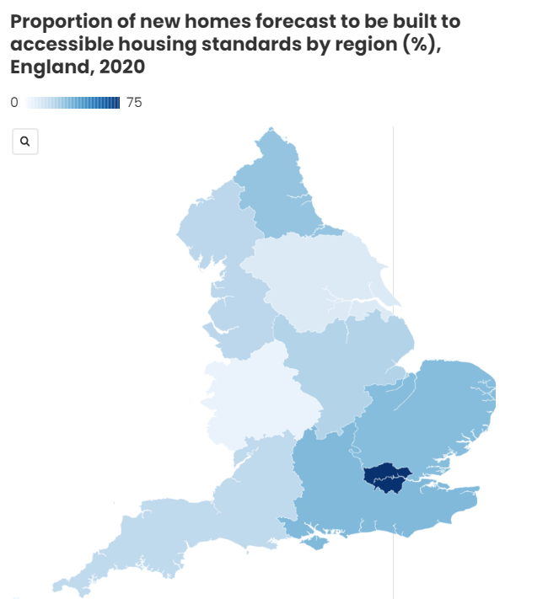
The pipeline of new accessible homes varies markedly across the country

Slide 43
Health
More people are living with illness and disability in their later years, and life expectancy is falling – but the picture is worst for the poorest in society.

Slide 44
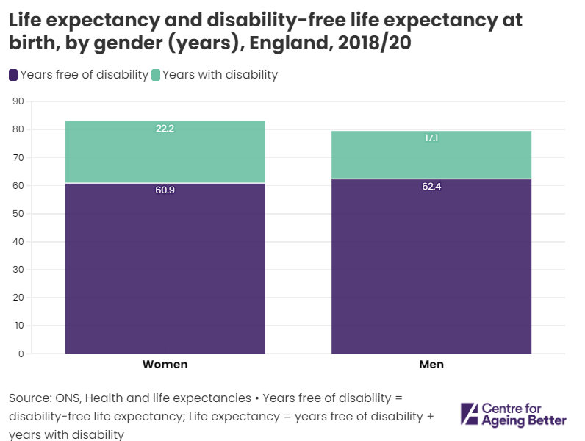
At birth boys can expect that more than 21% of their lives will be in poor health; for girls, it is almost 27%

Slide 46
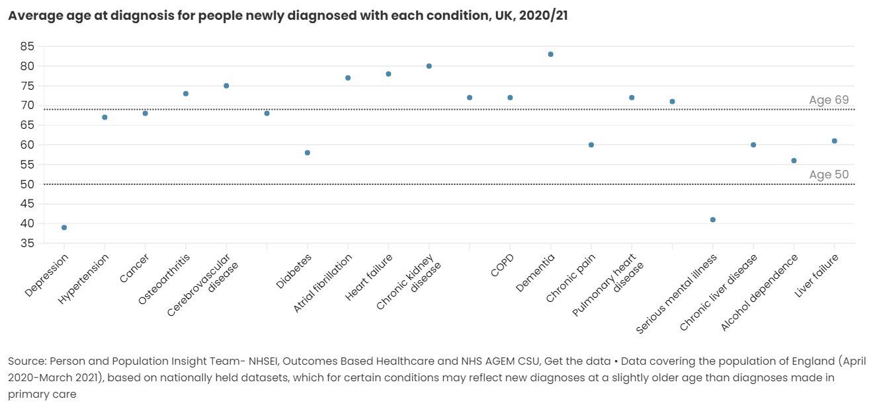
If we are to make ageing better, we must delay the age of onset of common chronic conditions

Slide 47
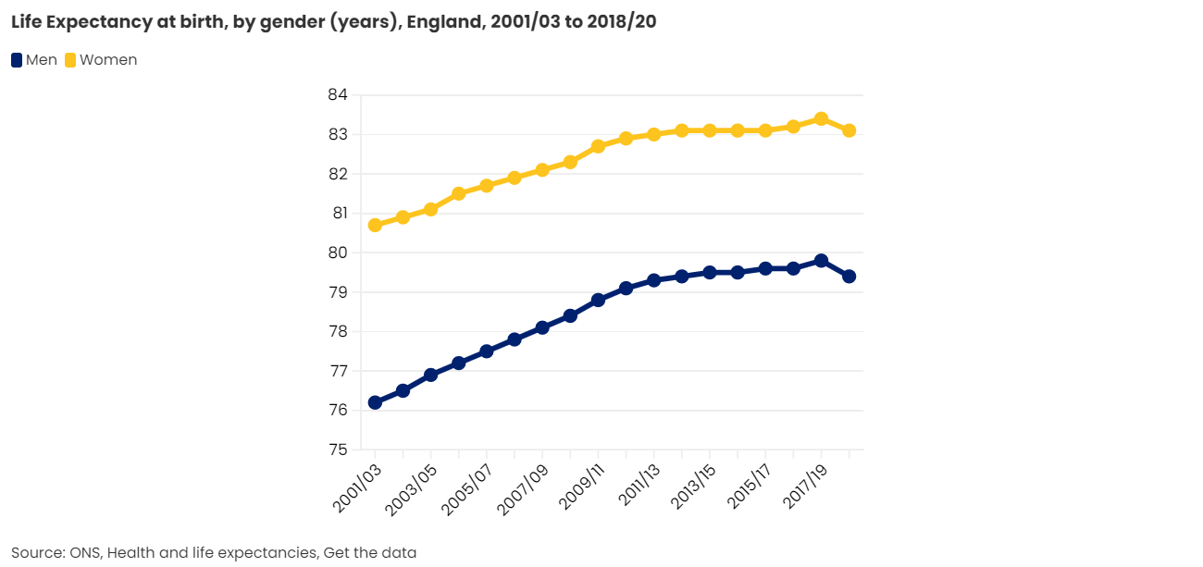
As a result of the pandemic, life expectancy has fallen in England for men and women

Slide 48
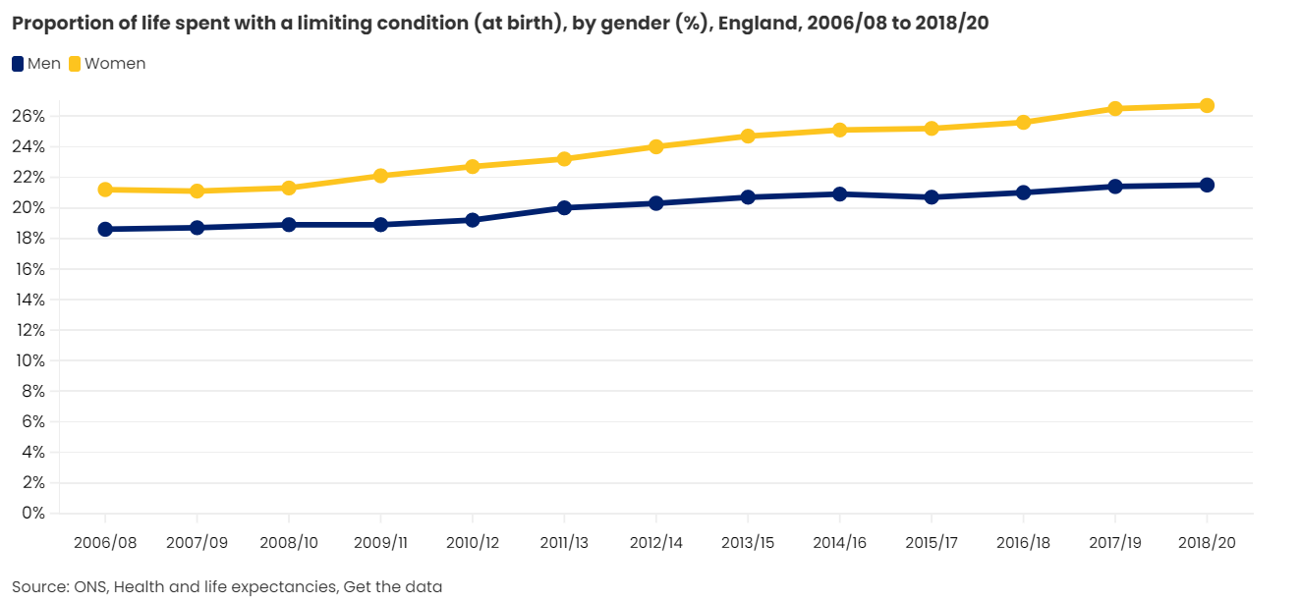
We are living an ever bigger proportion of our lives with disability

Slide 49
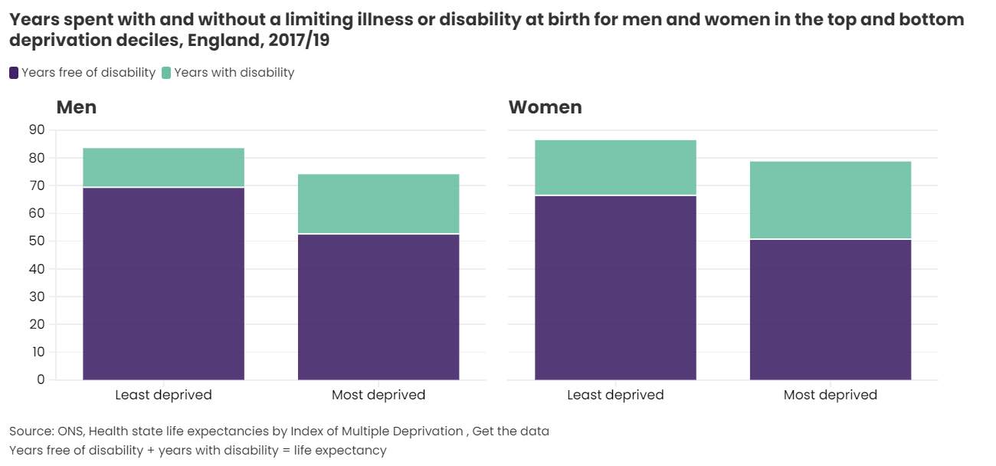
People in the most deprived areas have shorter lives and spend more of them in ill-health than people in the least deprived areas

Slide 50
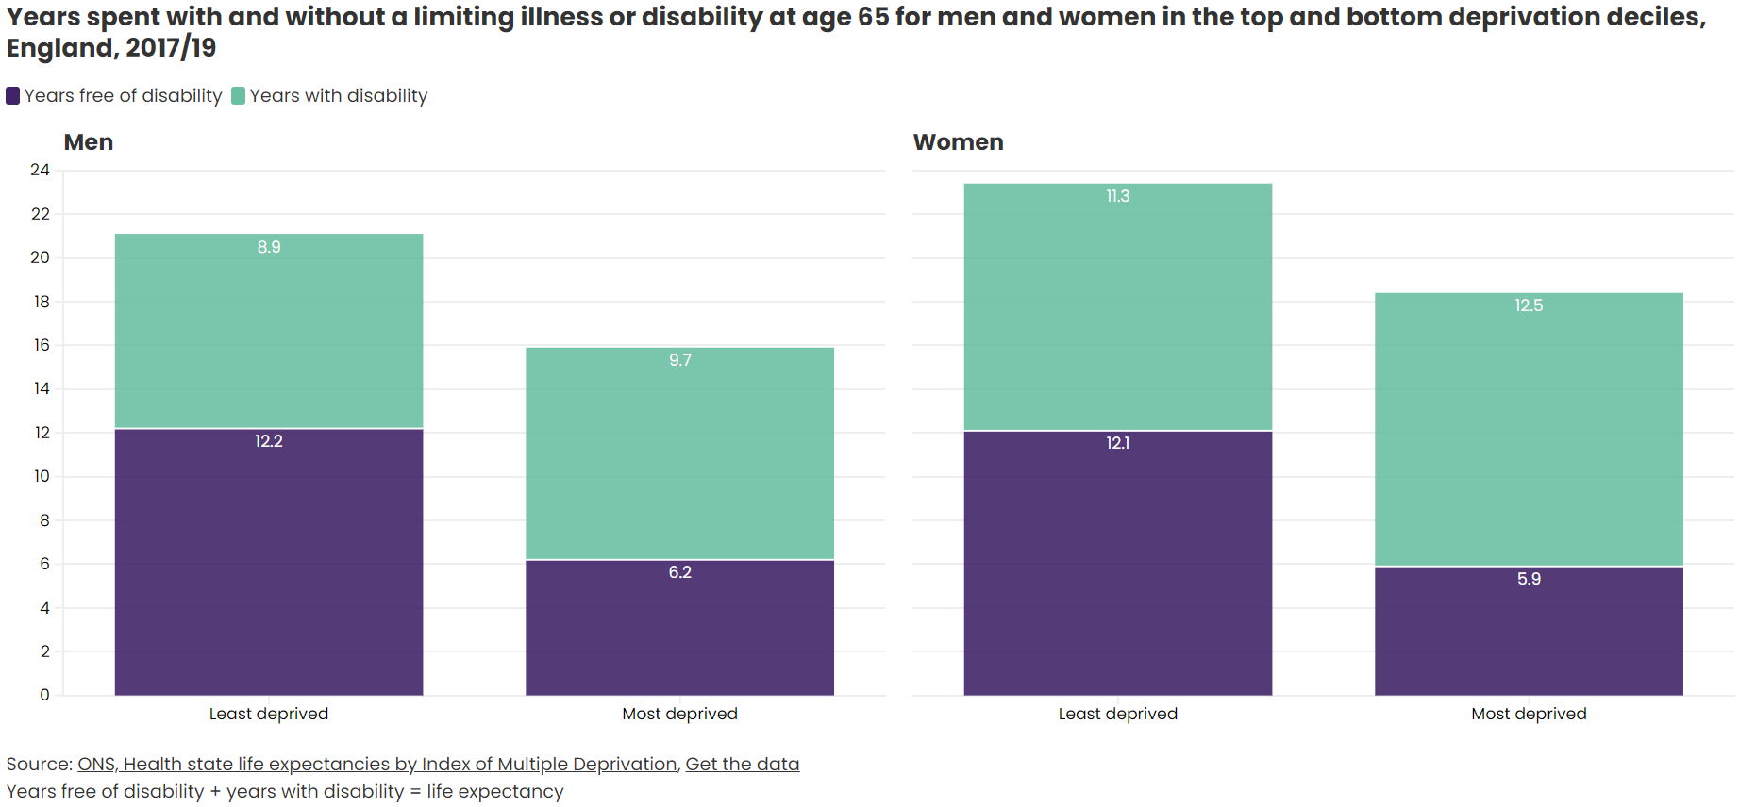
At age 65 men and women in the most deprived areas will have half as many years free of disability as those in the least deprived areas

Slide 51
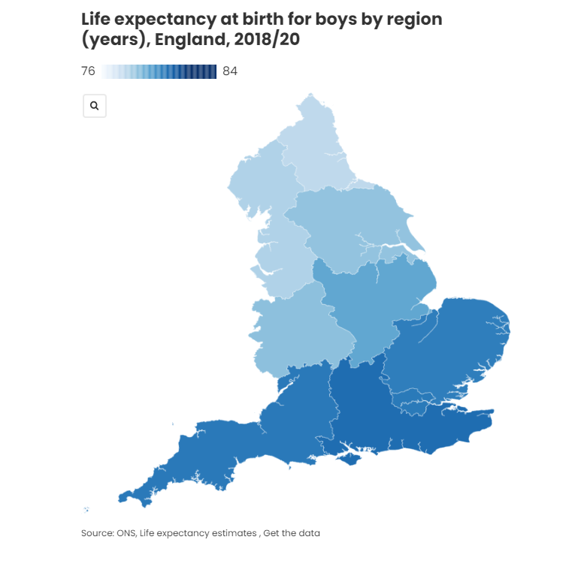
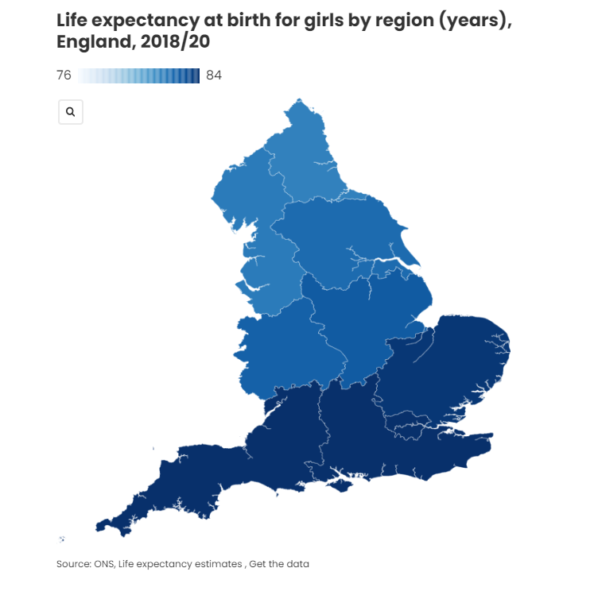
People living in the South of England live longer and healthier lives than people living in the North

Slide 52
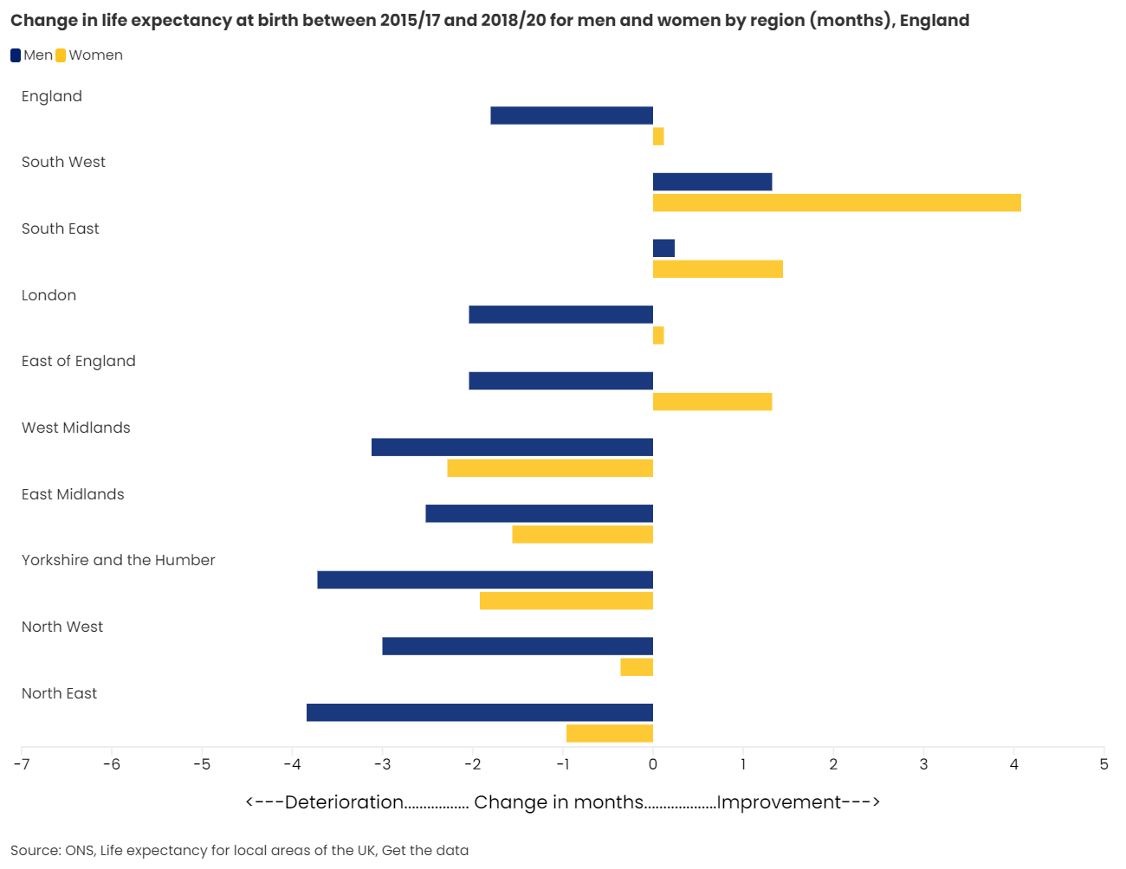
The largest falls in life expectancy since 2015/17 are in the North East for men and in the West Midlands for women

Slide 53
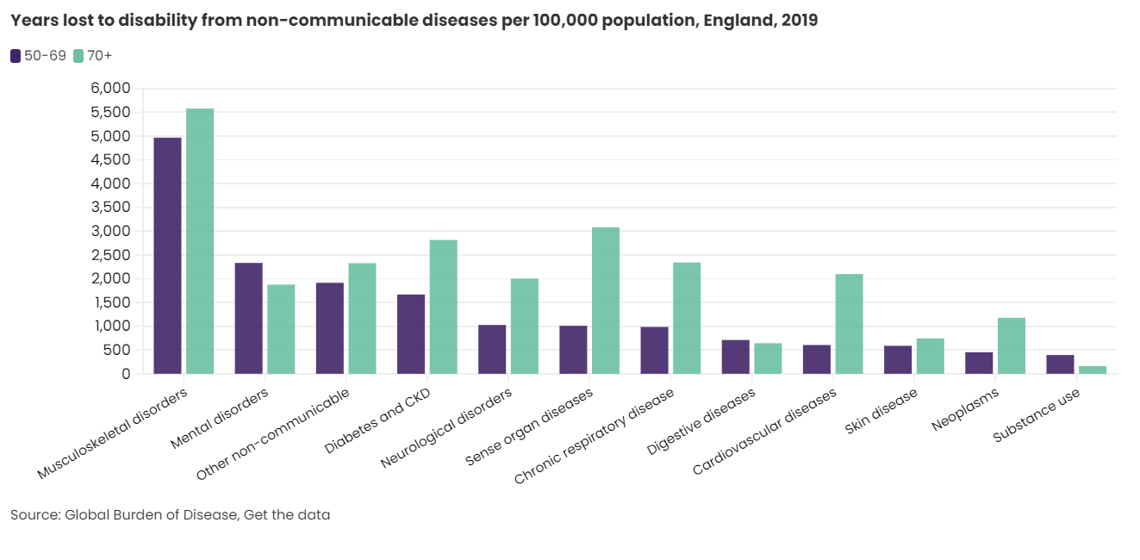
Musculoskeletal disorders cause the most years in poor health for people aged 50 and over

Slide 54
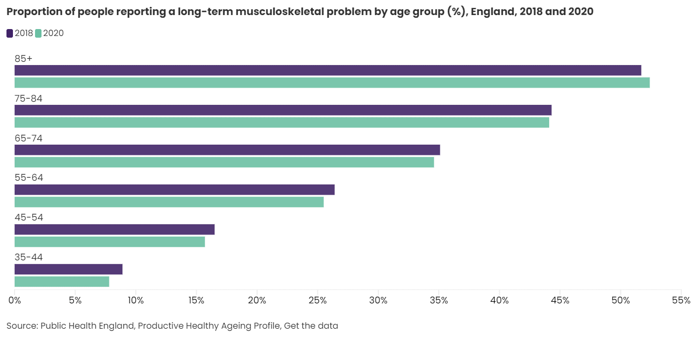
More than a quarter of people in mid-life suffer with a long-term musculoskeletal condition

Slide 55
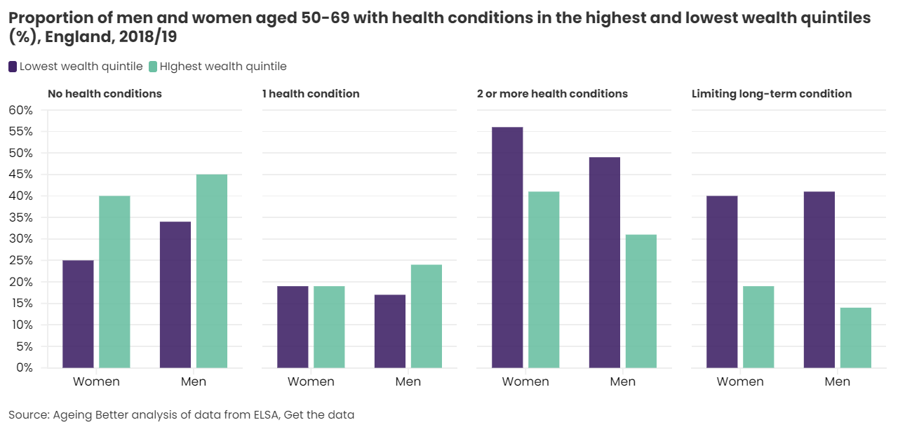
Poor health is more common in those who are less well-off

Slide 56
Poor health is more common in those less well-off

Slide 57
The poorer you are the more likely you are to have these common health conditions

Slide 58
There is wide variation across the country in the prevalence of long-term health conditions

Slide 59
Levels of poor health vary across ethnic groups and are highest in people of Bangladeshi and Pakistani background

Slide 60
The extent to which poor health is limiting is greatest in people of Bangladeshi and Pakistani background

Slide 61
Our wellbeing is associated with whether or not we have long-term health conditions and how much they impact our day-to-day lives

Slide 62
The proportion of people who are physically inactive increases sharply with age

Slide 63
Progress towards greater levels of activity among the over 75s has been lost during the pandemic

Slide 64
People in the poorest neighbourhoods are more than twice as likely to be physically inactive as people in the wealthiest

Slide 65
For all age groups walking is a far more common form of active travel than cycling

Slide 66
There has been a sharp increase in the proportion of people walking for at least 20 minutes three or more times a week

Slide 67
Rates of overweight or obesity are high in every age group

Slide 68
The proportion of people who are overweight or obese has increased over time in every age group

Slide 69
Men are far more likely to smoke than women at all ages

Slide 70
Almost one-third of the poorest men aged 50 and older still smoke

Slide 71
Smoking rates vary widely across the country

Slide 72
Men aged 55-74 are the most likely to drink at levels that put them at risk

Slide 73
There were 280,000 alcohol-related admissions in 2020/21; more than half were in people aged 55 and over

Slide 74
There are twice as many hospital admissions for alcohol related conditions in the poorest people aged 40-64 as there are in the wealthiest

Slide 75
Communities
Despite the importance of staying connected to our communities, inequalities are shaping people's quality of life and access to support.

Slide 76
Older people feel the greatest sense of belonging to their neighbourhoods, but the gap with younger people is closing

Slide 77
People who might need most support took longest to improve community connections during the pandemic

Slide 78
The gender support gap is widest in our fifties and sixties

Slide 79
Awareness of support available from voluntary groups is lowest among people who might need it most

Slide 80
Informal volunteering increased in the pandemic, while formal volunteering declined

Slide 81
People who live in less deprived areas are more likely to volunteer – although the gap is much smaller for informal volunteering

Slide 82
Helping out in neighbourhoods declined following the crisis response early in the pandemic

Slide 83
2020 saw a dramatic rise in internet use among the over 75s

Slide 84
Digital exclusion in mid-life is twice as high among disabled people as their peers

Slide 85
Over 3 million people aged 55 and over have never been online

Slide 86
Local authority spending on key community services fell sharply in the decade between 2010/11 and 2019/20

Slide 87
Thank you
For more information please contact info@ageing-better.org.uk

